Slide 1
STRATEGIC PLAN
2020 - 2025

Slide 2
Aims
To provide, through Pony Club, a positive, safe & inclusive environment for the personal & sporting development of our members, coaches & volunteers.
Mission
To encourage young people to ride & learn to enjoy all kinds of sport connected with horses & riding.
To provide instruction in riding, horsemanship risk management & the proper care & treatment of their animals
To cultivate in our members, strength of character & self-discipline by promoting the highest ideals of sportsmanship, citizenship, loyalty & respect.

Slide 3
Our Stakeholders
Members,
Coaches,
Volunteers.
Sponsors,
Partners,
Suppliers,
Zone 6,
Sunshine Coast Council
Pony Club Queensland
Pony Club Australia

Slide 4
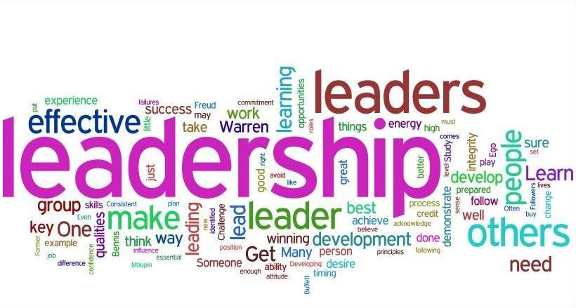
Our Executive Structure
President
Vice President
Secretary
Treasurer

Slide 5
Our Volunteers
Chief Instructor | Sun Safe Coordinator
First Aid Officer | Social Media Coordinator
Zone 6 Delegates x 2 | Agistment Officer
Canteen Coordinator | Horse Health Welfare Officer
Council Representative | Fire Warden
Grants Coordinator | Groundsman
Registration Coordinator | Volunteer Coordniator
Uniform and Merchandise Coordinator | Junior Liaison Representative
Member Protection Officer | Sponsorship Officer

Slide 6
Future Direction
Creating a positive Club Culture;
Financially viable organisation.
Raising the Club profile across Zone 6 and the wider equine community;
Welcoming new members and families to the Club;
Regular, Open and Transparent communication with members;
Building the Club participation numbers through regular events and increased memberships; and
Enhancing facilities for the wider community use;

Slide 7
Focus areas - Goal or objective
Instruction & participation Rally days: To run meaningful, safe, and well structured rallies. Equipment for all activities To have enough equipment at any one time for a variety of activities; to have a maintenance/replacement programme. Training of instructors To always have trained and able instructors available, no matter the disciplines offered nor the ability of the groups. External instructors Provision of instruction by external instructors, in a variety of disciplines as required by current membership. Recruiting & retaining members To attract and keep Club members.
Facilities & equipment
Safe & suitable grounds An excellent equine facility suitable not only for Club use, but also for holding training and other events. Suitable equipment To provide correct equipment for use in the canteen and the grounds.
Xcountry course To have a Xcountry course running the perimeter of the grounds
Administration Running costs: To run the Club as efficiently and effectively as possible. Publicity & PR To be recognised as a leader in our field by the non-equine community as well as other equine groups
Networking Develop links with other equine groups
Volunteers To retain and fully utilise the skills and expertise of our volunteers
Management committee To proactively manage the Club utilising this strategic plan in planning & decision making.
Finance Operational budgets Produce a projected 5 year budget based on this strategic plan.
Grants Apply for all suitable grants as they become available
Fundraising Ensure the Club raises enough funds to continue to provide excellence in tuition and facilities for its members.

Slide 8
Priorities for the Club
Priority | Details | Cost | Funding Source | Action Officer | Timeframe
1 | Purchase/replace jumping equipment to improve safety - poles, key hole tracks, break-away cups and jump cups. | $5000.00 | Grant, events, fundraising | Claudia Laird | 6 months
2 | Instructor Training, outsourcing | $2000.00/year | memberships | Chief Instructor | ongoing
3 | Repair grounds to safe standard. Develop maintenance plan Investigate cost of purchasing equipment over outsourcing. | $40,000.00 | grants | Committee | Over 2 years
4 | XC Cross country course | $75,000.00 | grant | Committee | 3 –5 years
5 | Solar/Battery system for the Clubhouse | $6,000.00 | Grant, events, fundraising | Committee | 1 year
6 | Tractor with slasher, bucket and harrow | $35,000 | grants | Committee | 1-2 years
7 | Covered arena with stables | $200,000.00 | Grants | Committee | 3-5 years
8

Slide 9
Income Sources
Sponsorships
Events
Agistment
Fundraising Activities
Memberships
Grants

